Slide 1
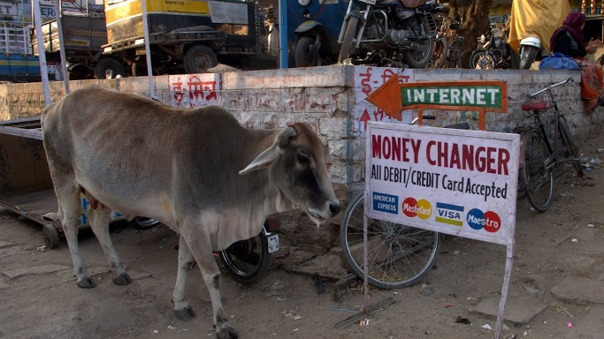
Class 5:
Distributed Consensus
Cryptocurrency Café
UVa cs4501 Spring 2015
David Evans

Slide 2
Plan for Today
Preventing Double Spending
Chaum’s Scheme
Distributed Consensus
Byzantine Generals
Bitcoin’s Solution

Slide 3
Signatures are Not Enough
How can we prevent double spending?

Slide 4
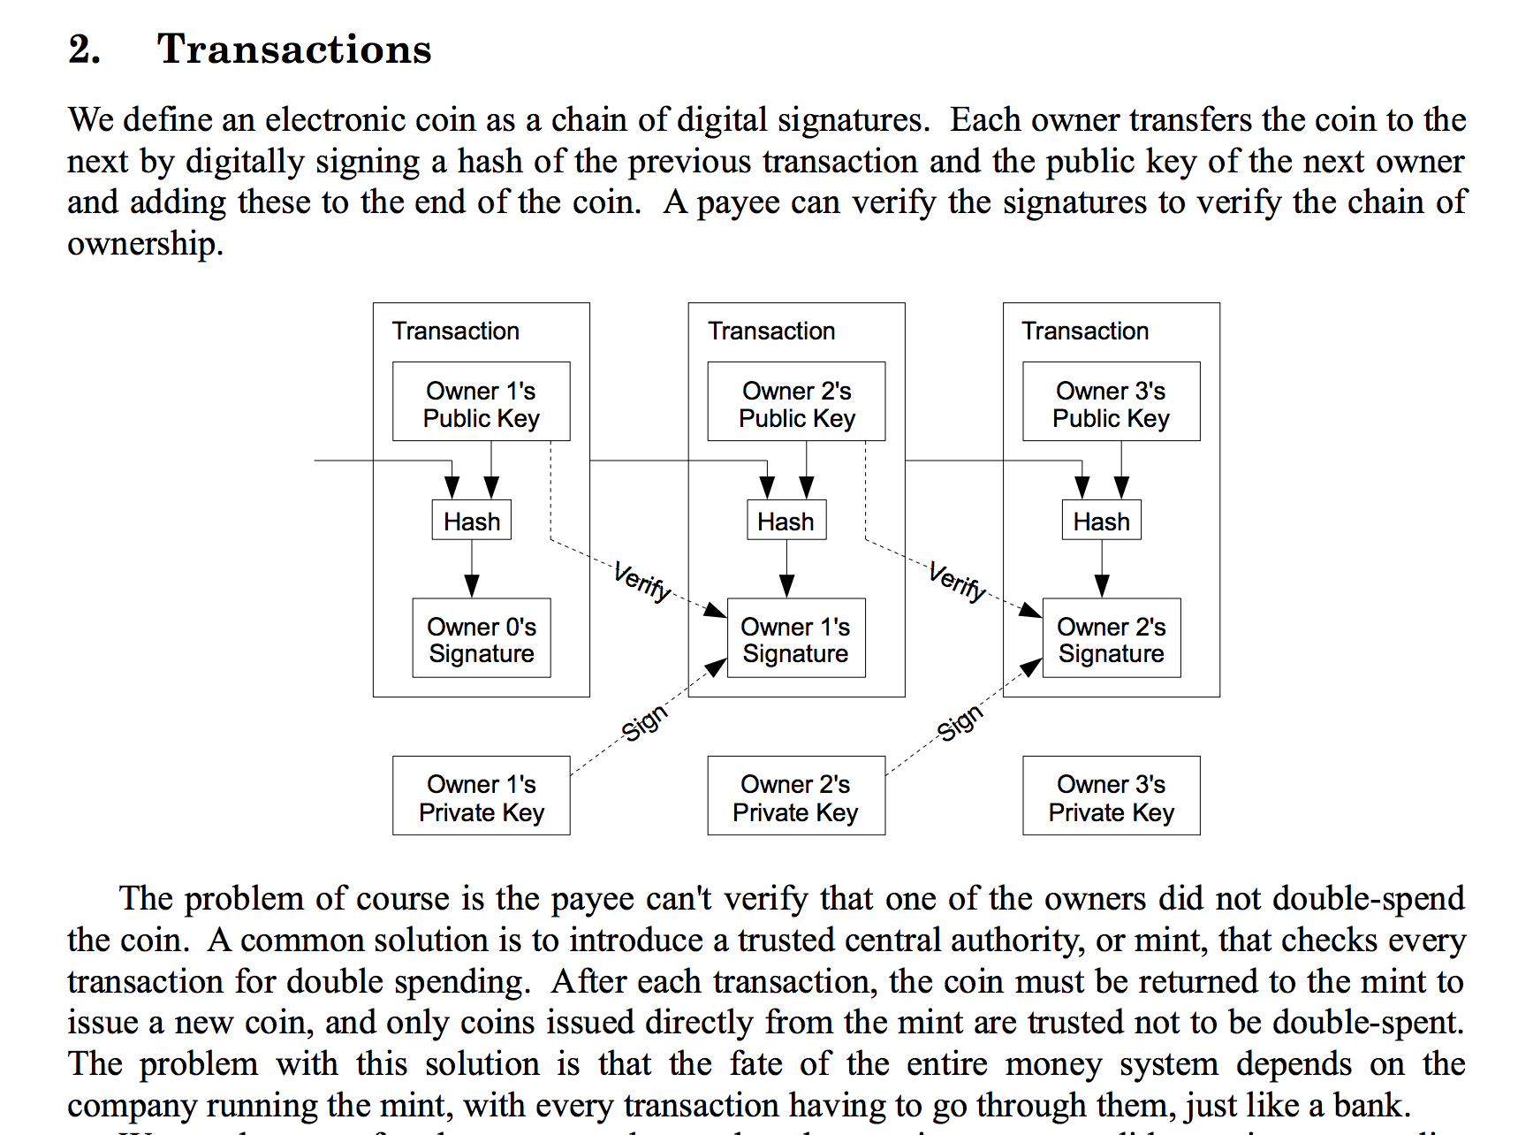
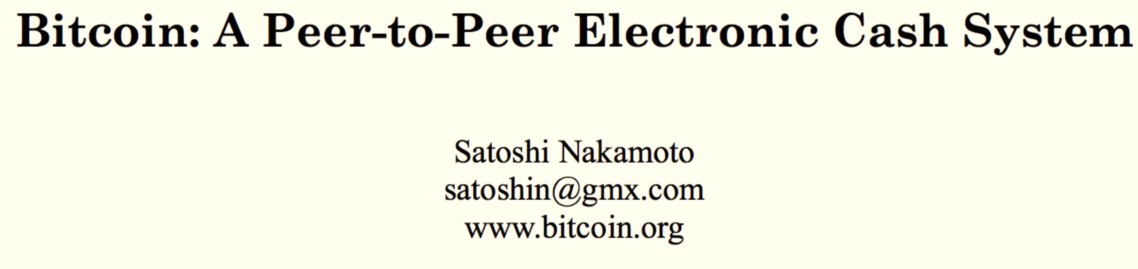

Slide 5
Using a Mint

Slide 6
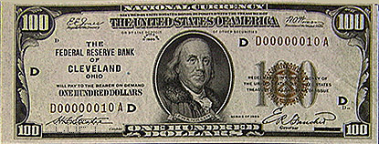
Bank IOU Protocol
High
Trust
Bank
Alice
{KU_{A}, KR_{A}}
M
E_{KRTB}[H(M)]
M = “The High Trust Bank owes the holder of this message $100.”
{KU_{TB}, KR_{TB}}

Slide 7
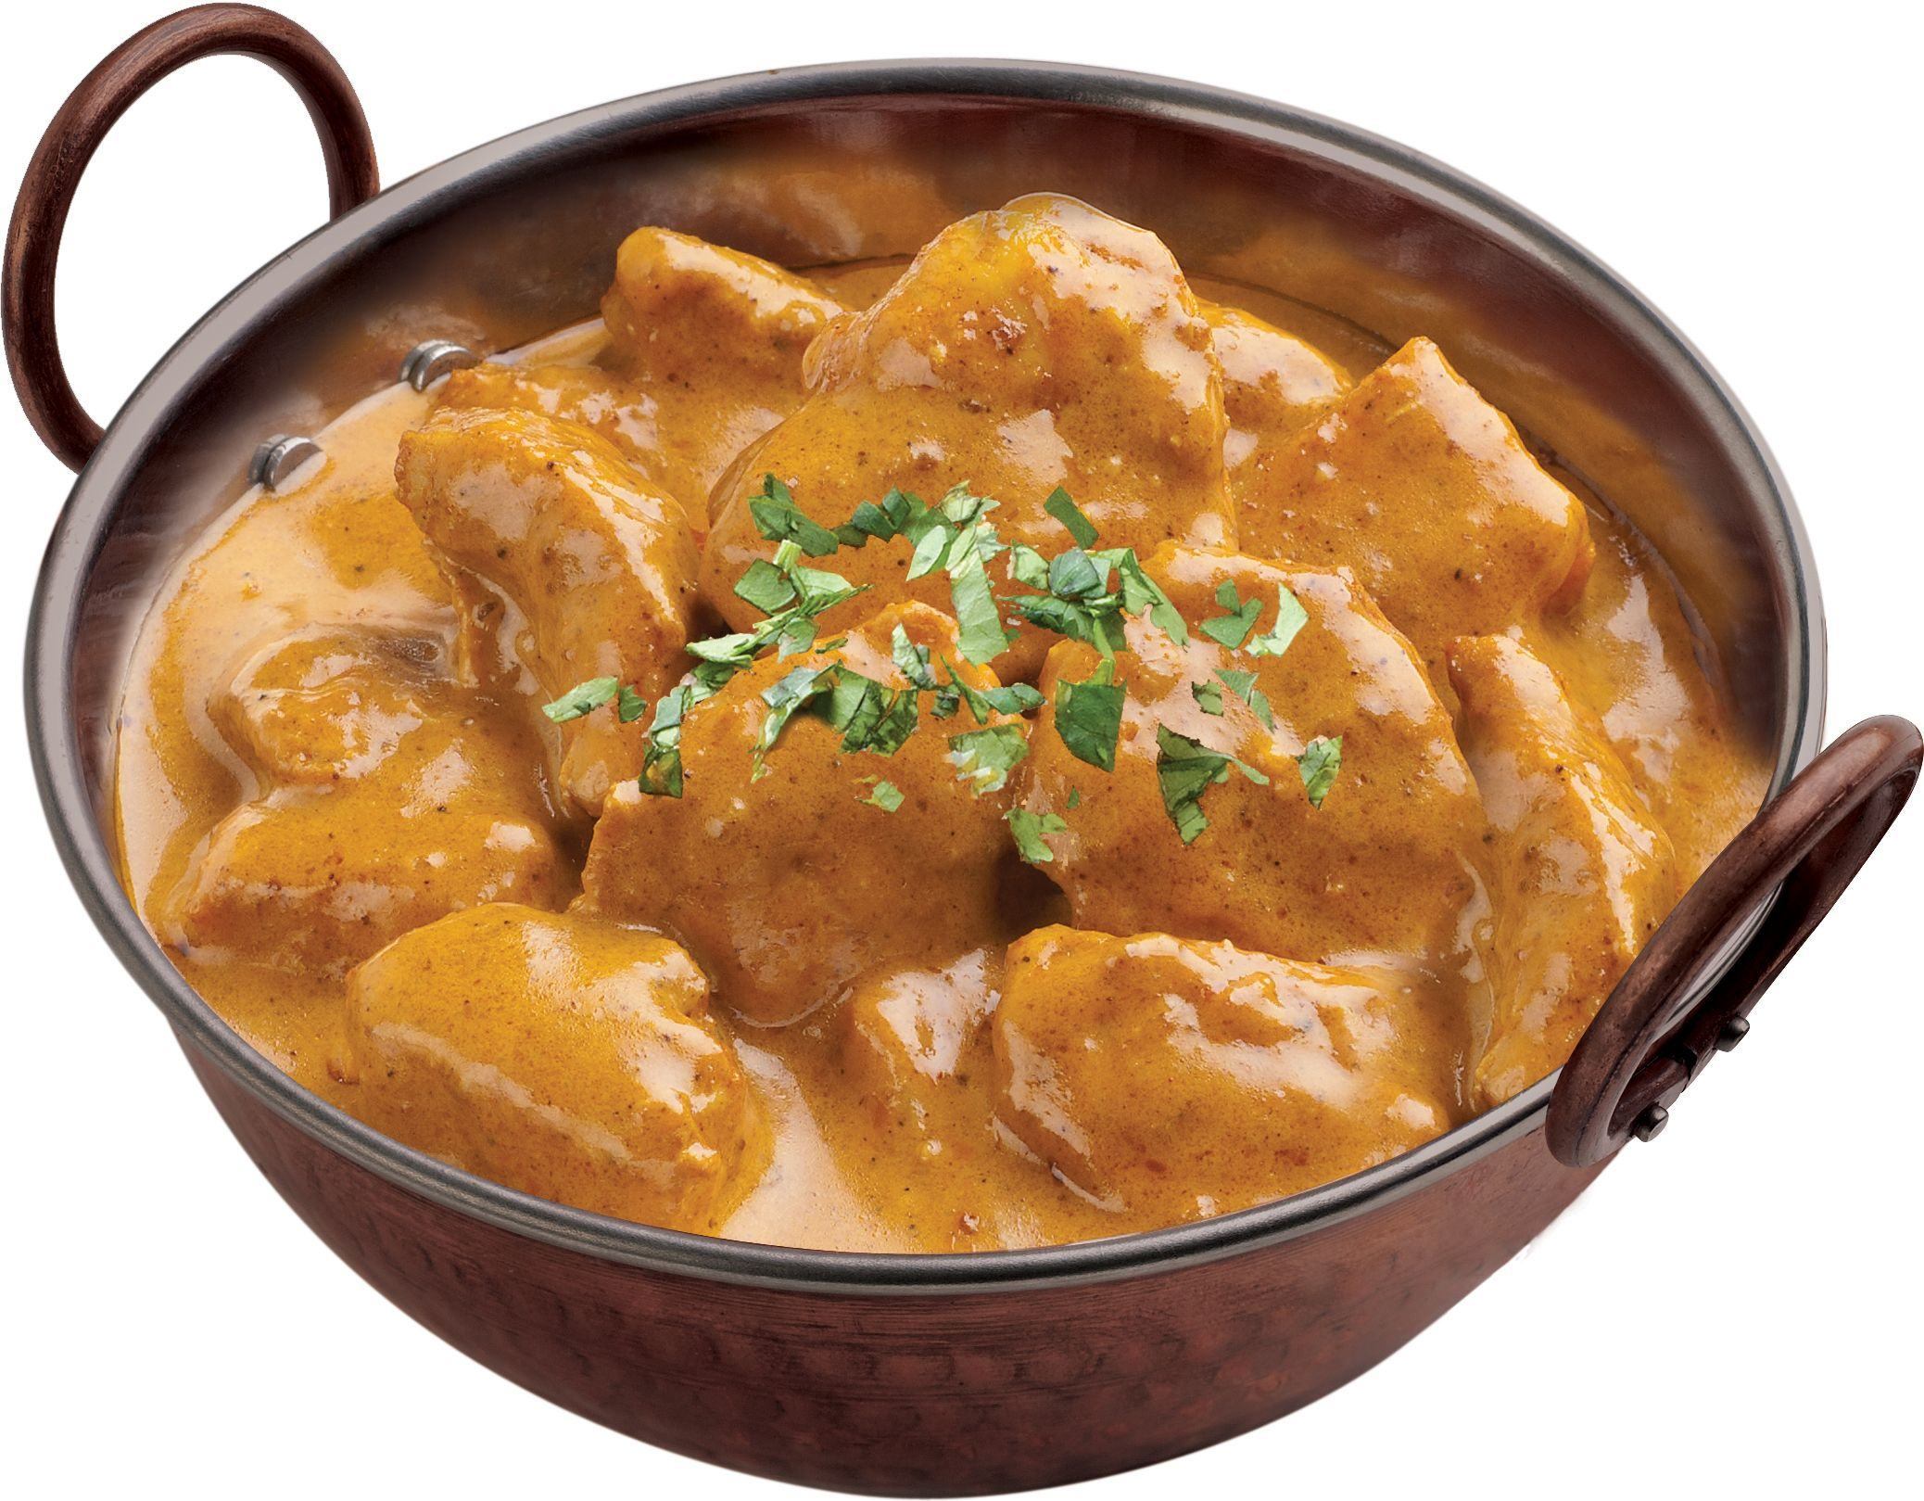
High
Trust
Bank
Alice
Bob
M
E_{KRTB}[H(M)]
M
E_{KRTB}[H(M)]
M = “The High Trust Bank owes the holder of this message $100.”
{KU_{TB}, KR_{TB}}
E_{KUA}[secret curry recipe]
M
E_{KRTB}[H(M)]

Slide 8
High
Trust
Bank
Alice
Bob
M
E_{KRTB}[H(M)]
M
E_{KRTB}[H(M)]
M = “The High Trust Bank owes the holder of this message $100.”
{KU_{TB}, KR_{TB}}
E_{KUA}[secret curry recipe]
M
E_{KRTB}[H(M)]

Slide 9
Bank IOU Protocol
Trusty
Bank
M
E_{KRTB}[H(M)]
Alice
{KU_{TB}, KR_{TB}}
{KU_{A}, KR_{A}}
M
E_{KRTB}[H(M)]
Bob’s secret curry recipe
E_{KUA}[Bob’s secret curry recipe]
Bob

Slide 10
Bank IOU Protocol
M
E_{KRTB}[H(M)]
Trusty
Bank
Bob
M
E_{KRTB}[H(M)]
M
E_{KRTB}[H(M)]

Slide 11
Bank IOU Protocol
Universally recognized as valuable
Easy to transfer
Anonymous
Heavy
Moderately difficult to counterfeit in small quantities
Extremely difficult to get away with counterfeiting large quantities

Slide 12
Bank Identifiers
Bank adds a unique tag to each IOU it generates
When someone cashes an IOU, bank checks that that IOU has not already been cashed
Can’t tell if it was Alice or Bob who cheated
Alice loses her anonymity – the bank can tell where she spends her money

Slide 13
Digital Cash, Protocol #1
Alice prepares 100 money orders for $1000 each.
Puts each one in a different sealed envelope, with a piece of carbon paper.
Gives envelopes to bank.
Bank opens 99 envelopes and checks they contain money order for $1000.
Bank signs the remaining envelope without opening it (signature goes through carbon paper).

Slide 14
Digital Cash, Protocol #1 cont.
Bank returns envelope to Alice and deducts $1000 from her account.
Alice opens envelope, and spends the money order.
Merchant checks the Bank’s signature.
Merchant deposits money order.
Bank verifies its signature and credits Merchant’s account.

Slide 15
Digital Cash, Protocol #1
Is it anonymous?
Can Alice cheat?
Make one of the money orders for $100000, 1% chance of picking right bill, 99% chance bank detects attempted fraud.
Better make the penalty for this high (e.g., jail)
Copy the signed money order and re-spend it.
Can Merchant cheat?
Copy the signed money order and re-deposit it.

Slide 16
Digital Cash, Protocol #2
Idea: prevent double-spending by giving each money order a unique ID.
Problem: how do we provide unique IDs without losing anonymity?
Solution: let Alice generate the unique IDs, and keep them secret from bank.

Slide 17
Digital Cash, Protocol #2
Alice prepares 100 money orders for $1000 each, adds a long, unique random ID to each note.
Puts each one in a different sealed envelope, with a piece of carbon paper.
Gives envelopes to bank.
Bank opens 99 envelopes and checks they contain money order for $1000.
Bank signs the remaining envelope without opening it.

Slide 18
Digital Cash, Protocol #2 cont.
Bank returns envelope to Alice and deducts $1000 from her account.
Alice opens envelope, and spends the money order.
Merchant checks the Bank’s signature.
Merchant deposits money order.
Bank verifies its signature, checks that the unique random ID has not already been spent, credits Merchant’s account, and records the unique random ID.

Slide 19
Digital Cash, Protocol #2
Is it anonymous?
Can Alice cheat?
Can Merchant cheat?
Can bank catch cheaters?

Slide 20
Mimicking Carbon Paper
How does bank sign the envelope without knowing what it contains?
Normal signatures
Alice sends bank M
Bank sends Alice, S_{M} = E_{KRBank} (M)
Alice shows S_{M} to Bob who decrypts with banks public key.

Slide 21
Blind Signatures
Alice picks random k between 1 and n.
Sends bank t = mk^{e} mod n. (e from Bank’s public key).
Bank signs t using private key d. Sends Alice:
t^{d} = (mk^{e} mod n)^{d} mod n
= (mk^{e})^{d} mod n ≡ m^{d}k^{ed} mod n
= (mk^{e})^{d} mod n ≡ m^{d}k^{ed} mod n
What do we know about k^{ed} mod n?

Slide 22
Blind Signatures
Alice gets
t^{d} ≡ m^{d}k mod n
Alice divides by k to get
s_{m} ≡ m^{d}k / k ≡ m^{d} mod n.
Hence: bank can sign money orders without opening them!

Slide 23
Digital Cash Protocol #2
Instead of envelopes, Alice blinds each money order using a different randomly selected k_{i}.
The bank asks for any 99 of the k_{i}’s. The bank unblinds the messages (by dividing) and checks they are valid.
The bank signs the other money order.
Still haven’t solved the catching cheaters problem!

Slide 24
Anonymity for Non-Cheaters
Spend a bill once – maintain anonymity
Spend a bill twice – lose anonymity
Have we seen anything like this?

Slide 25
Digital Cash
Alice prepares n money orders each containing:
Amount Uniqueness String: X
Identity Strings: I₁ = (h(I_{1L}), h(I_{1R}))
...
I_{n} = (h(I_{nL}), h(I_{nR}))
Each I_{n} pair reveals Alice’s identity (name, address, etc.). I = I_{iL} ⊕ I_{iR}.
h is a secure, one-way hash function.

Slide 26
Digital Cash, cont.
Alice blinds (multiplies by random k) all n money orders and sends them to bank.
Bank asks for any n-1 of the random k_{i}s and all its corresponding identity strings.
Bank checks money orders. If okay, signs the remaining blinded money order, and deducts amount from Alice’s account.

Slide 27
Digital Cash, cont.
Alice unblinds the signed note, and spends it with a Merchant.
Merchant asks Alice to randomly reveal either I_{iL} or I_{iR} for each i. (Merchant chooses n-bit selector string.)
Alice sends Merchant corresponding I_{iL}’s or I_{iR}’s.
Merchant uses h to confirm Alice didn’t cheat.

Slide 28
Digital Cash, cont.
Merchant takes money order and identity string halves to bank.
Bank verifies its signature, and checks uniqueness string. If it has not been previously deposited, bank credits Merchant and records uniqueness string and identity string halves.

Slide 29
Digital Cash, cont.
If it has been previously deposited, bank looks up previous identity string halves. Finds one where both L and R halves are known, and calculates I. Arrests Alice.
If there are no i’s, where different halves are known, arrest Merchant.

Slide 30
Digital Cash Protocol
Universally recognized as valuable
Easy to transfer
Anonymous
Heavy
Moderately difficult to counterfeit in small quantities
Extremely difficult to get away with counterfeiting large quantities

Slide 31
Digital Cash Summary
Preserves anonymity of non-cheating spenders (assuming large bank and standard denominations)
Doesn’t preserve anonymity of Merchants
Requires a trusted off-line bank
Expensive – lots of computation for one transaction
Other schemes (Peppercoin, Millicent, CyberCoin, NetBill, etc.) proposed for smaller transactions

Slide 32
Charge
Project 1 is due Friday
If you haven’t already read Satoshi’s original bitcoin paper and Chapter 5, please do before Wednesday’s class
Office Hours today!
Me: now
Nick: 5-7pm in Rice 442
Project 1 Due Friday, 11:59pm

